Slide 1
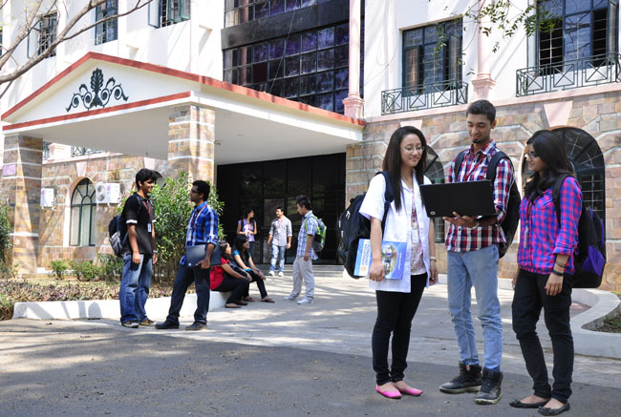

B.Tech Computer Science and Engineering – Vth Semester
Theory of Computation
Department of Computer Science and Engineering

Slide 2
Trees – Parse Trees
A parse tree is a pictorial representation of a derivation.
Every derivation in a CFG can be represented using a tree.
In a tree
The root node is always the starting symbol.
All intermediate nodes are variables.
All leaf nodes are terminals.
The string obtained by the derivation can be seen by reading the leaf nodes of the parse tree from left to right.

Slide 3
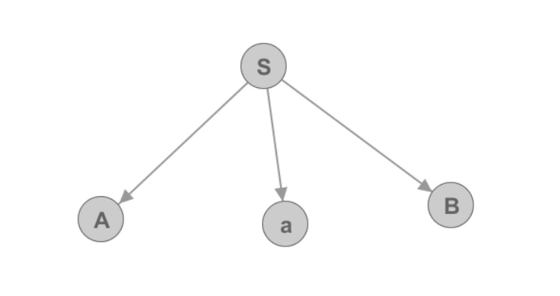
Yield of a parse tree
Every derivation will end up in obtaining the string of terminals.
So is the parse tree, the string obtained by the parse tree is called as the yield of the tree.
The production S->AaB will have a equivalent tree as follows

Slide 4
Yield of a parse tree
The sub trees for these individual productions can be recursively defined to represent a full derivation.

Slide 5
Ambiguous Grammar
If a CFG has more than one right most derivation or more than one left most derivation then the CFG is said to be a ambiguous grammar.
So for proving the ambiguity of a grammar we need to show two left most derivation or two right most derivation for a string.
A tree is not sufficient to prove the ambiguity of the grammar

Slide 6
Ambiguous Grammar
If a CFG has more than one right most derivation or more than one left most derivation then the CFG is said to be a ambiguous grammar.
So for proving the ambiguity of a grammar we need to show two left most derivation or two right most derivation for a string.
A tree is not sufficient to prove the ambiguity of the grammar

Slide 7
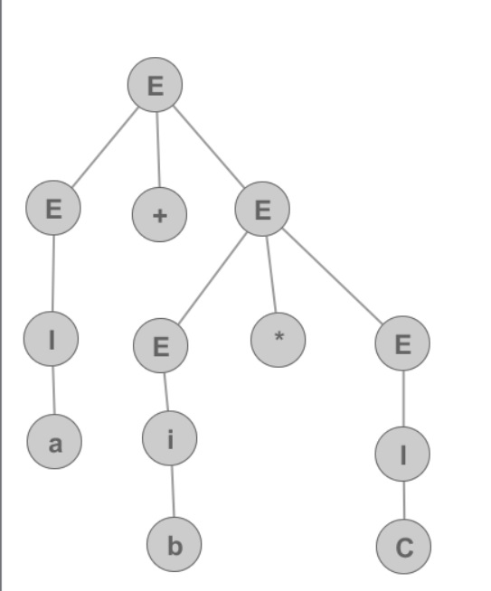
Left Most Derivation and Trees
G= E->E+E|E*E|(E)|I
I->a|b|c
Left Most Derivation “a+b*c”
E->E+E
->I+E
->a+E
->a+E*E
->a+I*E
->a+b*E
->a+b*I
->a+b*c

Slide 8
Right Most Derivation and Trees
First Right Most Derivation “a+b*c”
E->E+E
->E+E*E
->E+E*I
->E+E*c
->E+I*c
->E+b*c
->I+b*c
->a+b*c

Slide 9
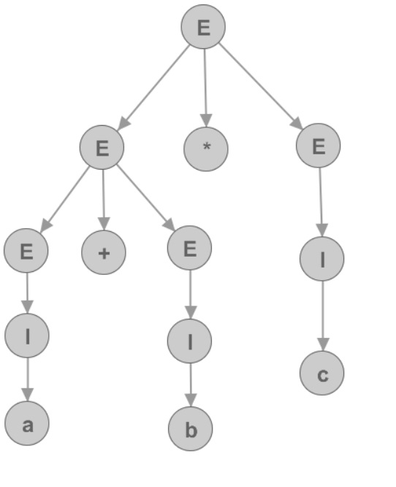
Right Most Derivation and Trees
Second Right Most Derivation “a+b*c”
E->E*E
->E*I
->E*c
->E+E*c
->E+I*c
->E+b*c
->I+b*c
->a+b*c

Slide 10
Trees for two Right Most Derivation – existence of two trees for same string is a proof for an ambiguous grammar.

